Slide 1
Natural Topographies: Data Formulations
March 13, 2022

Slide 2
Code Used
Results from Using the Program to Compute the Configuration Variables:
2D-CVM-def-pttrns_anlytc-FE-vary-e1-v1pt5_2021-04-08.py
Updated:
2D-CVM-def-pttrns_anlytc-FE-vary-e1-v1pt5_2022-03-14.py
Data Sets and Associated Code Patterns:
Nat. Top. #1: Pattern 1
Nat. Top. #2:
Nat. Top. #3, v. (a): Pattern 3
Nat. Top. #3, v. (b): Pattern 4

Slide 3
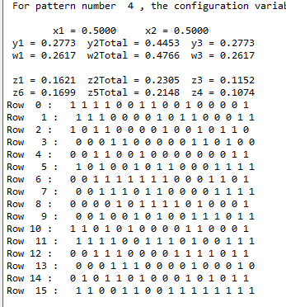
Natural Topography #3
Version (b)
Results from Using the Program to Compute the Configuration Variables:
2D-CVM-def-pttrns_anlytc-FE-vary-e1-v1pt5_2021-04-08.py
Used Pattern 4 for this trial.
Select Configuration Variables:
z1: 0.1621
z3: 0.1152
y2: 0.445/2 = 0.223

Slide 4

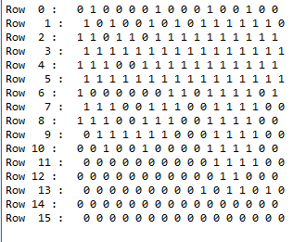
Row 15*
*wrap-around
Natural Topography #1: Highest Cohesion
Node Activations Entered into Program
Row 0
Row 1
Row 2
Row 3
Row 4
Row 5
Row 6
Row 7
Row 8
Row 9
Row 10
Row 11
Row 12
Row 13
Row 14
Row 15

Slide 5
Natural Topography #2
Version (a)
Natural Topography #2: Moderate Dispersion
Numbers of Black Nodes
Row 15*
*wrap-around
Row 0: 6 (4,2)
Numbers of Black Nodes
Summary:
Row 1: 4 (2,2)
Row 0
Row 2: 2 (0,2)
Row 1
Row 3: 10 (2,8)
Top Half: 44 (x, x)
Bottom Half: 84 (x, x)
Row 2
Row 4: 10 (2,8)
Row 3
Row 5: 2 (0,2)
Row 4
Row 6: 4 (2,2)
Row 5
Total: 128
Row 7: 6 (4,2)
Row 6
Row 8: 12 (6,6)
Row 7
Row 9: 8 (4,4)
Row 8
Row 10: 12 (8,4)
Row 9
Row 11: 10 (6,4)
Row 10
Row 12: 10 (6,4)
Row 11
Row 13: 12 (8,4)
Row 12
Row 13
Row 14: 8 (4,4)
Row 14
Row 15: 12 (6,6)
Row 15

Slide 6
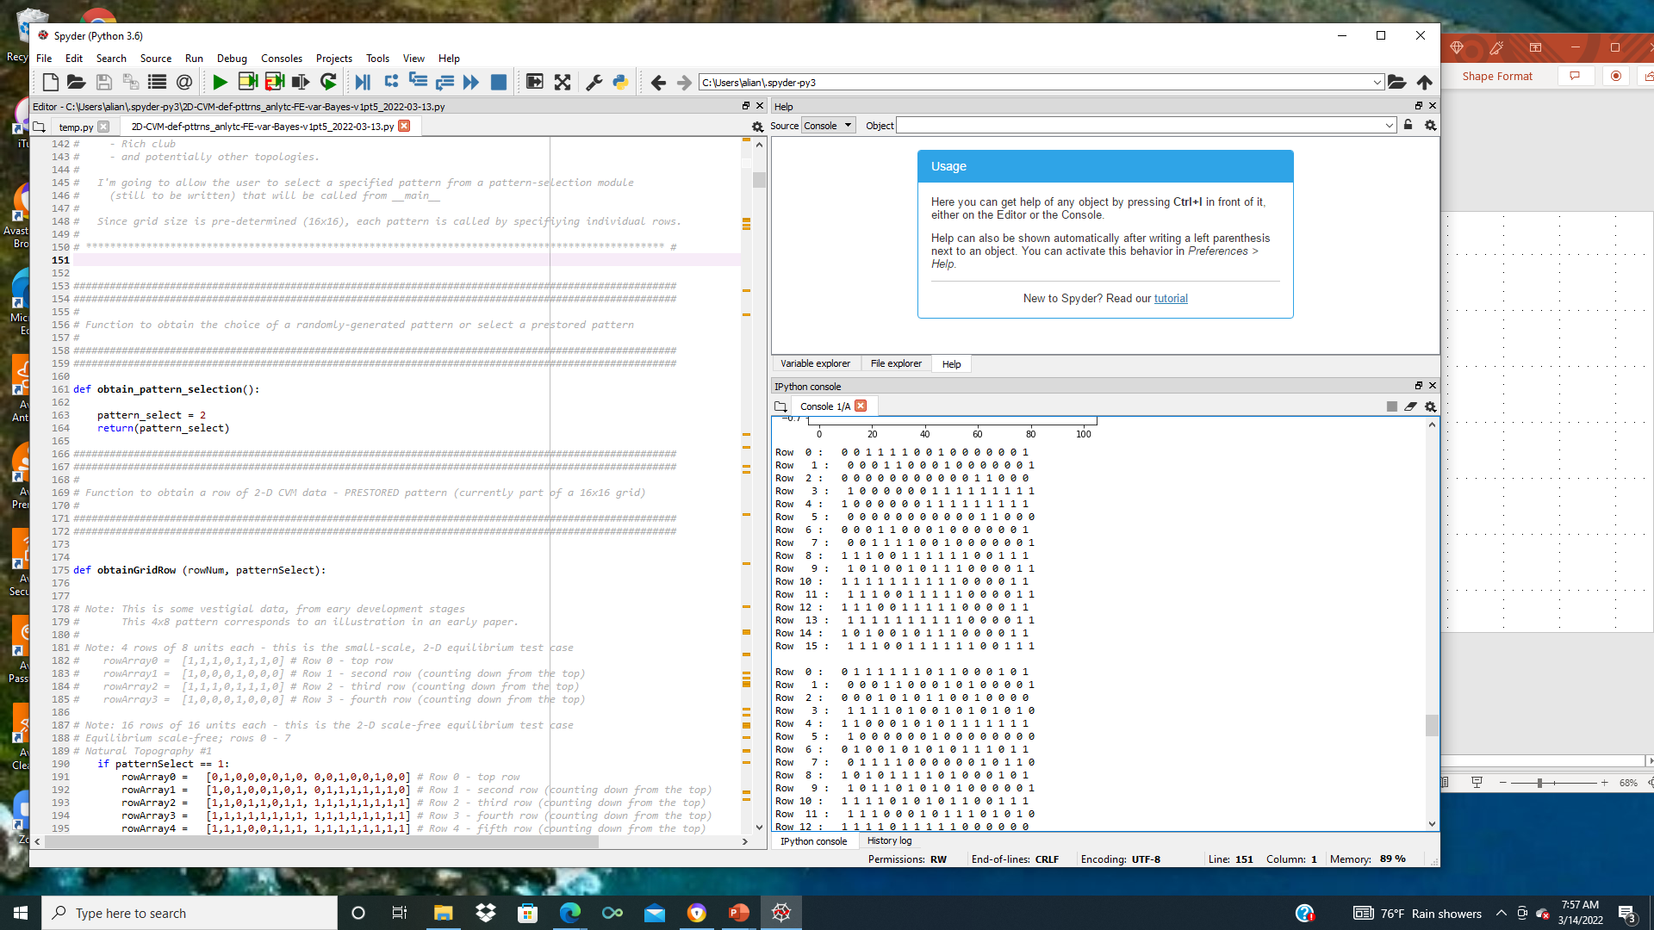
Natural Topography #2: Moderate Dispersion
Row 15*
*wrap-around
Row 0
Row 1
Row 2
Row 3
Row 4
Row 5
Row 6
Row 7
Row 8
Row 9
Row 10
Row 11
Row 12
Row 13
Row 14
Row 15

Slide 7
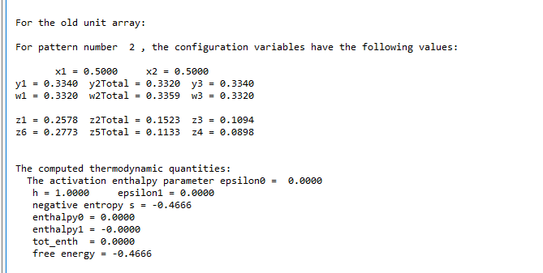

Slide 8
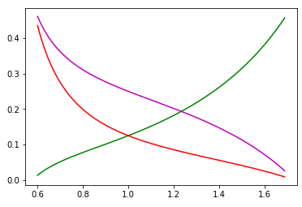
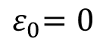
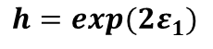
We Can Obtain Analytic Results for Certain Cases
Natural Topography #2
Analytic Values for Configuration Variables y₂, z₁, and z₃
Case where activation enthalpy : x₁ = x₂ = 0.5
$${ ε}_{0}=0$$
B
A
A
y₂
Z₃:
Z₁:
y₂:
B
B
A
A
A
A
A
z₁
y₂
z₁
z₃
Configuration variable
h = 1 (ε₁ = 0)
Nat. Top. #2:
z₃
y₂ = 0.166
z₁ = 0.258
z₃ = 0.109
h: interaction enthalpy parameter;
$${ h=exp(2ε}_{1})$$

Slide 9
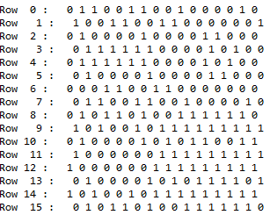
NOTE: Originally had this noted as V (a).
Corrected 2022/03/14
Natural Topography #3
Version (b)
Row 15*
*wrap-around
Natural Topography #3: High Dispersion
Row 0
Row 1
Row 2
Row 3
Row 4
Row 5
Row 6
Row 7
Row 8
Row 9
Row 10
Row 11
Row 12
Row 13
Row 14
Row 15
NOTE: Correcting first node (0,0) position: Changed from black to white, to meet computer code (see RHS) version w/ verified x=0.5. Corrected 2022/03/14

Slide 10
Natural Topography #3
Version (b)
Using four of the 8x8 grid overlays to create a 16x16 grid
Row 15*
*wrap-around
Natural Topography #3: High Dispersion
Numbers of Black Nodes
Row 0
Row 0: 8 (6,2)
Row 1
Row 1: 8 (4,4)
Row 2
Row 2: 7 (3,4)
Numbers of Black Nodes
Summary:
Row 3
Row 3: 5 (2,3)
Row 4
Row 4: 5 (3,2)
Top Half: 61 (33, 28)
Bottom Half: 67 (30, 37)
Row 5
Row 5: 9 (4,5)
Row 6
Row 6: 10 (6,4)
Row 7
Row 7: 9 (5,4)
Row 8
Row 8: 7 (3,4)
Row 9
Row 9: 8 (3,5)
Row 10
Row 10: 7 (4,3)
Row 11
Row 11: 11 (6,5)
Row 12
Row 12: 9 (3,6)
Row 13
Row 13: 5 (3,2)
Row 14
Row 14: 8 (4,4)
Row 15
Row 15: 12 (4,8)

Slide 11
Natural Topography #3
Version (b)
Results from Using the Program to Compute the Configuration Variables:
2D-CVM-def-pttrns_anlytc-FE-vary-e1-v1pt5_2021-04-08.py
Used Pattern 4 for this trial.
Select Configuration Variables:
z1: 0.1621
z3: 0.1152
y2: 0.445/2 = 0.223

Slide 12
Configuration Variable Values and Corresponding h-values
Tpgrphy | Pattern | z₁ | z₃ | y₂ | h-value (low) | h-value (high)
1 | 1 | 0.3145 | 0.0645 | 0.125 | 1.45 | 1.55
2 | 2 | 0.2578 | 0.1094 | 0.166 | 1.05 | 1.35
3(a) | 3 | 0.1816 | 0.1152 | 0.211 | 1.05 | 1.19
3(b) | 4 | 0.1621 | 0.1152 | 0.223 | 1.05 | 1.15

Slide 13
We Can Obtain Analytic Results for Certain Cases
Natural Topography #1
Analytic Values for Configuration Variables y₂, z₁, and z₃
Case where activation enthalpy : x₁ = x₂ = 0.5
$${ ε}_{0}=0$$
B
A
A
y₂
Z₃:
Z₁:
y₂:
B
B
A
A
A
A
A
z₁
y₂
z₁
z₃
Configuration variable
h = 1 (ε₁ = 0)
Nat. Top. #1:
z₃
y₂ = 0.250/2
= 0.125
z₁ = 0.315
z₃ = 0.065
h: interaction enthalpy parameter;
$${ h=exp(2ε}_{1})$$

Slide 14
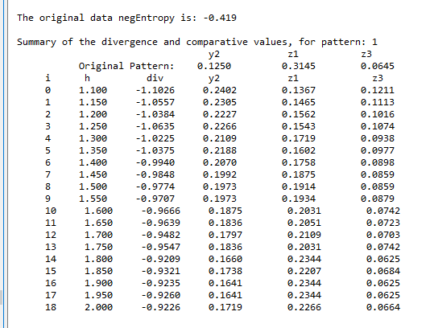
REVISED CODE: Pattern #1, Rich-Club-Like; 2022-03-30; Run #1

Slide 15

REVISED CODE: Pattern #1, Rich-Club-Like; 2022-03-30; Run #2

Slide 16

REVISED CODE: Pattern #1, Rich-Club-Like; 2022-03-30; Run #3

Slide 17

REVISED CODE: Pattern #1, Rich-Club-Like; 2022-03-30; Run #4

Slide 18

REVISED CODE: Pattern #1, Rich-Club-Like; 2022-03-30; Run #5

Slide 19

REVISED CODE: Pattern #1, Rich-Club-Like; 2022-03-30; Run #6

Slide 20
AVERAGE OF RESULTS: Pattern #1, Rich-Club-Like; 2022-03-30
Run Numb. | h | Diverg. | y₂ | z₁ | z₃
1 | 1.80 | -0.9209 | 0.1660 | 0.2344 | 0.0625
2 | 2.00 | -0.9140 | 0.1523 | 0.2520 | 0.0527
3 | 1.85 | -0.9286 | 0.1621 | 0.2402 | 0.0566
4 | 1.95 | -0.9124 | 0.1602 | 0.2441 | 0.0605
5 | 1.90 | -0.9329 | 0.1660 | 0.2285 | 0,0645
6 | 1.95 | -0.9138 | 0.1621 | 0. 2326 | 0,0645
AVG. | 1.91 |  | 0.1614 | 0.2386 | 0.0602

Slide 21
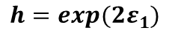
We Can Obtain Analytic Results for Certain Cases
Natural Topography #1
Analytic Values for Configuration Variables y₂, z₁, and z₃
Case where activation enthalpy : x₁ = x₂ = 0.5
$${ ε}_{0}=0$$
B
A
A
y₂
Z₃:
Z₁:
y₂:
B
B
A
A
A
A
A
z₁
y₂
z₁
z₃
Configuration variable
h = 1 (ε₁ = 0)
Orig.
Model
z₃
Nat. Top. #1:
Nat. Top. #1:
y₂ = 0.250/2
= 0.125
y₂ = 0.161
z₁ = 0.315
z₁ = 0.239
z₃ = 0.065
z₃ = 0.060
h: interaction enthalpy parameter;
$${ h=exp(2ε}_{1})$$

Slide 22
We Can Obtain Analytic Results for Certain Cases
Natural Topography #2
Analytic Values for Configuration Variables y₂, z₁, and z₃
Case where activation enthalpy : x₁ = x₂ = 0.5
$${ ε}_{0}=0$$
B
A
A
y₂
Z₃:
Z₁:
y₂:
B
B
A
A
A
A
A
z₁
y₂
z₁
z₃
Configuration variable
h = 1 (ε₁ = 0)
Nat. Top. #2:
z₃
y₂ = 0.166
z₁ = 0.258
z₃ = 0.109
h: interaction enthalpy parameter;
$${ h=exp(2ε}_{1})$$

Slide 23
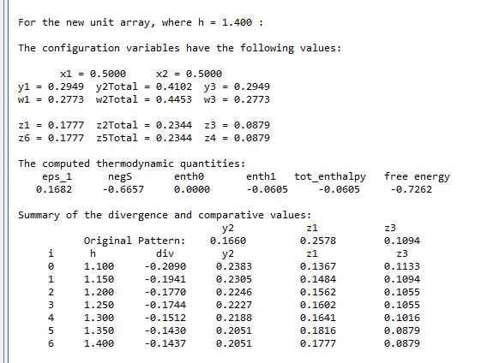
Pattern #2, Intermediate; 2022-03-30; Run #1

Slide 24

Pattern #2, Intermediate; 2022-03-30; Run #2

Slide 25

Pattern #2, Intermediate; 2022-03-30; Run #2

Slide 26
We Can Obtain Analytic Results for Certain Cases
Natural Topography #3
Version (a)
Analytic Values for Configuration Variables y₂, z₁, and z₃
Case where activation enthalpy : x₁ = x₂ = 0.5
$${ ε}_{0}=0$$
B
A
A
y₂
Z₃:
Z₁:
y₂:
B
B
A
A
A
A
A
z₁
y₂
z₁
z₃
Configuration variable
h = 1 (ε₁ = 0)
Nat. Top. #3:
z₃
y₂ = 0.422/2
= 0.211
z₁ = 0.182
z₃ = 0.115
h: interaction enthalpy parameter;
$${ h=exp(2ε}_{1})$$

Slide 27

Pattern #3a, Weakly-Connected; 2022-03-30; Run #1

Slide 28

Pattern #3a, Weakly-Connected; 2022-03-30; Run #2

Slide 29

Pattern #3a, Weakly-Connected; 2022-03-30; Run #3

Slide 30
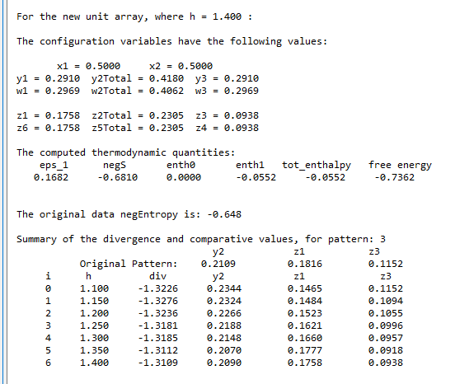
REVISED CODE: Pattern #3a, Weakly-Connected; 2022-03-30; Run #1

Slide 31

REVISED CODE: Pattern #3a, Weakly-Connected; 2022-03-30; Run #2

Slide 32

REVISED CODE: Pattern #3a, Weakly-Connected; 2022-03-30; Run #3

Slide 33
AVERAGE OF RESULTS: Pattern #3a, Weakly-Connected; 2022-03-30
Run Numb. | h | Diverg. | y₂ | z₁ | z₃
1 | 1.35 | -1.3109 | 0.2090 | 0.1768 | 0.0938
2 | 1.35 | -1.3093 | 0.2129 | 0.1777 | 0.0918
3 | 1.35 | -1.3089 | 0.2109 | 0.1738 | 0.0957
AVG. | 1.35 |  | 0.2109 | 0.1768 | 0.0938

Slide 34
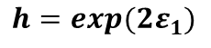
We Can Obtain Analytic Results for Certain Cases
Natural Topography #3
Version (a)
Analytic Values for Configuration Variables y₂, z₁, and z₃
Case where activation enthalpy : x₁ = x₂ = 0.5
$${ ε}_{0}=0$$
B
A
A
y₂
Z₃:
Z₁:
y₂:
B
B
A
A
A
A
A
z₁
y₂
z₁
z₃
Configuration variable
h = 1 (ε₁ = 0)
Orig.
Model
z₃
Nat. Top. #3:
Nat. Top. #1:
y₂ = 0.422/2
= 0.211
y₂ = 0.211
z₁ = 0.182
z₁ = 0.185
z₃ = 0.115
z₃ = 0.087
h: interaction enthalpy parameter;
$${ h=exp(2ε}_{1})$$

Slide 35
We Can Obtain Analytic Results for Certain Cases
Natural Topography #3
Version (b)
Analytic Values for Configuration Variables y₂, z₁, and z₃
Case where activation enthalpy : x₁ = x₂ = 0.5
$${ ε}_{0}=0$$
B
A
A
y₂
Z₃:
Z₁:
y₂:
B
B
A
A
A
A
A
z₁
y₂
z₁
z₃
Configuration variable
h = 1 (ε₁ = 0)
Nat. Top. #3:
z₃
y₂ = 0.445/2
= 0.223
z₁ = 0.162
z₃ = 0.115
h: interaction enthalpy parameter;
$${ h=exp(2ε}_{1})$$

Slide 36
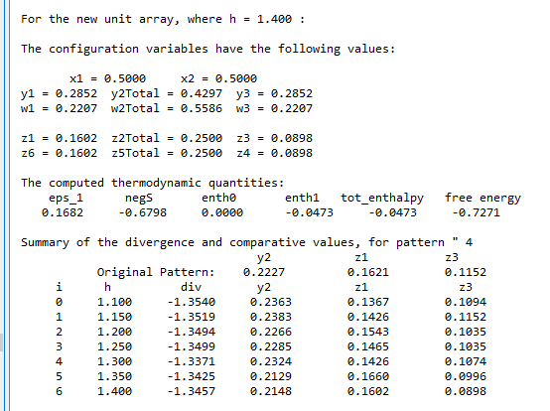
REVISED CODE: Pattern #3b, Weakly-Connected; 2022-03-30; Run #1

Slide 37
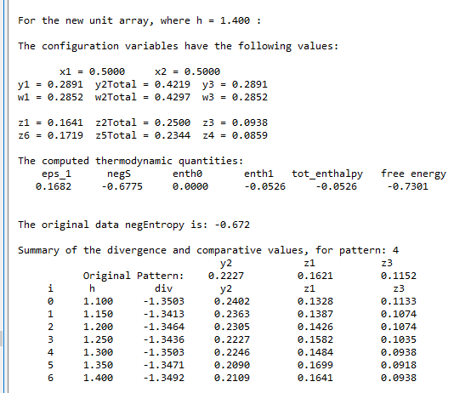
REVISED CODE: Pattern #3b, Weakly-Connected; 2022-03-30; Run #2

Slide 38
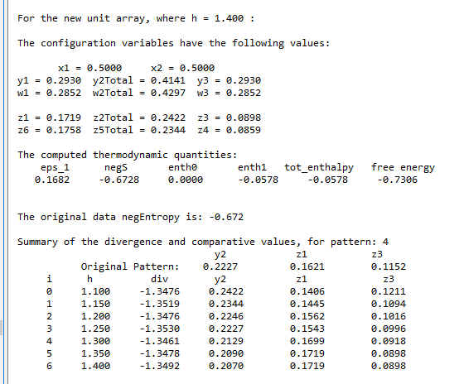
REVISED CODE: Pattern #3b, Weakly-Connected; 2022-03-30; Run #3

Slide 39
AVERAGE OF RESULTS: Pattern #3b, Weakly-Connected; 2022-03-30
Run Numb. | h | Diverg. | y₂ | z₁ | z₃
1 | 1.3 | -1.3371 | 0.2324 | 0.1426 | 0.1074
2 | 1.15 | -1.3413 | 0.2363 | 0.1387 | 0.1074
3 | 1.3 | -1.3463 | 0.2129 | 0.1689 | 0.0918
AVG. | 1.25 |  | 0.2273 | 0.1501 | 0.1022

Slide 40
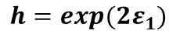
We Can Obtain Analytic Results for Certain Cases
Natural Topography #3
Version (b)
Analytic Values for Configuration Variables y₂, z₁, and z₃
Case where activation enthalpy : x₁ = x₂ = 0.5
$${ ε}_{0}=0$$
B
A
A
y₂
Z₃:
Z₁:
y₂:
B
B
A
A
A
A
A
z₁
y₂
z₁
z₃
Configuration variable
h = 1 (ε₁ = 0)
Orig.
Model
z₃
Nat. Top. #3:
Nat. Top. #1:
y₂ = 0.445/2
= 0.223
y₂ = 0.2273
z₁ = 0.162
z₁ = 0.150
z₃ = 0.115
z₃ = 0.102
h: interaction enthalpy parameter;
$${ h=exp(2ε}_{1})$$

